Slide 1

Fair UAV Deployment in Emergency Response: Optimising Routes with Column Generation and Q-Learning
Germán Pardo González
Camilo Gómez
Carlos Francisco Rodríguez

Slide 2
Agenda
Motivation
Mathematical models
Objectives
Column Generation approach
Q-Learning approach
Computational experiments
Conclusions and future work

Slide 3
Agenda
Motivation
Mathematical models
Objectives
Column Generation approach
Q-Learning approach
Computational experiments
Conclusions and future work

Slide 4
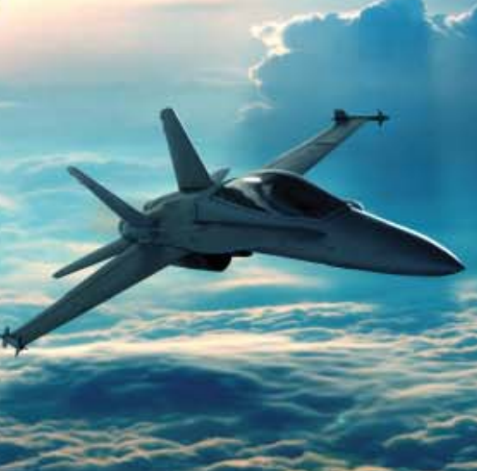
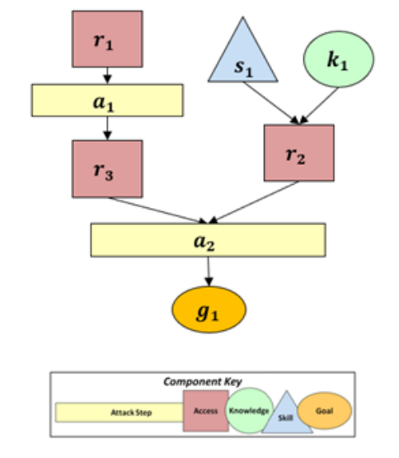
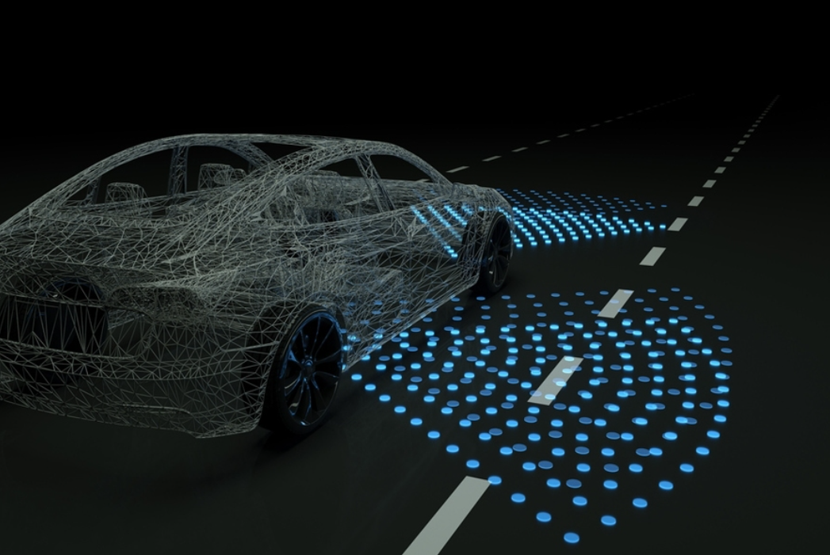
Reinforcement Learning in Cyber-Physical Systems
Modelled attacker agent using a universal optimisation framework
The solution method was Q-Learning and Value Iteration as a benchmark
Juan Betancourt Osorio, Germán Pardo González, Samuel Rodriguez Gonzalez, Daniel Cuellar, Camilo Gómez, Francesco Mariotti, Leonardo Montecchi, and Paolo Lollini. 2023. Modeling attacker behavior in Cyber-Physical-Systems. In Proceedings of the 11th Latin-American Symposium on Dependable Computing (LADC '22). Association for Computing Machinery, New York, NY, USA, 117–124. https://doi.org/10.1145/3569902.3570188

Slide 5
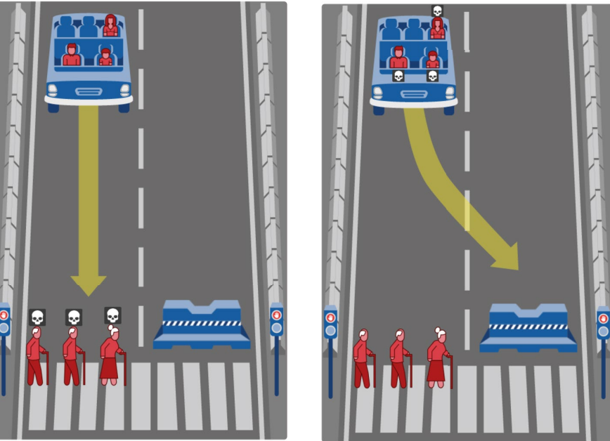
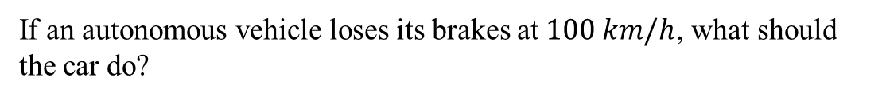
Ethical dilemmas in autonomous vehicles
If an autonomous vehicle loses its brakes at $100 km/h$, what should the car do?
Awad, E., Dsouza, S., Kim, R. et al. The Moral Machine experiment. Nature 563, 59–64 (2018). https://doi.org/10.1038/s41586-018-0637-6

Slide 6
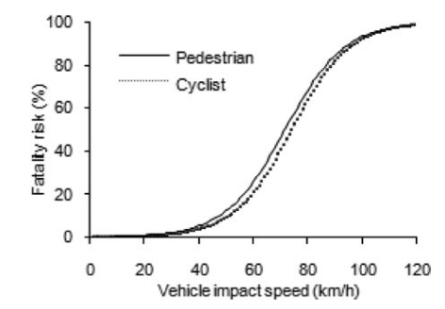
Fatality risk probability
Logistic regression to model probability of fatality
Works to quantify reward function depending on the philosophic theory
Jin Nie, Guibing Li & Jikuang Yang (2015) A Study of Fatality Risk and Head Dynamic Response of Cyclist and Pedestrian Based on Passenger Car Accident Data Analysis and Simulations, Traffic Injury Prevention, 16:1, 76-83, DOI: 10.1080/15389588.2014.881477

Slide 7
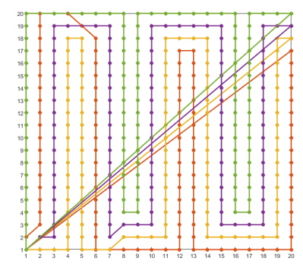

New context inspiration: UAV deployment in emergency response
Path planning using 4 different heuristics to maximise node coverage within a network in a emergency using UAVs
Considering the battery level as a random variable
A. Anastasiou, P. Kolios, C. Panayiotou and K. Papadaki, "Swarm Path Planning for the Deployment of Drones in Emergency Response Missions," 2020 International Conference on Unmanned Aircraft Systems (ICUAS), Athens, Greece, 2020, pp. 456-465, doi: 10.1109/ICUAS48674.2020.9213876.

Slide 8
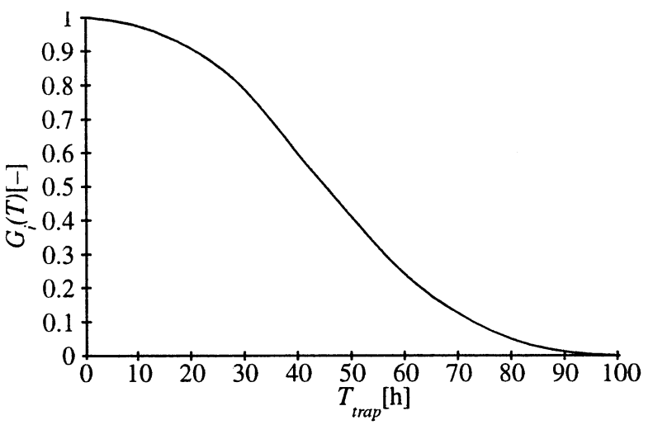
Relationship with survival probability
Probability function to quantify survival probabilty against time passed from the disaster
Works to quantify reward function and prioritise on the most vulnerable
F Fiedrich, F Gehbauer, U Rickers, Optimized resource allocation for emergency response after earthquake disasters, Safety Science, Volume 35, Issues 1–3, 2000, Pages 41-57, ISSN 0925-7535, https://doi.org/10.1016/S0925-7535(00)00021-7.

Slide 9
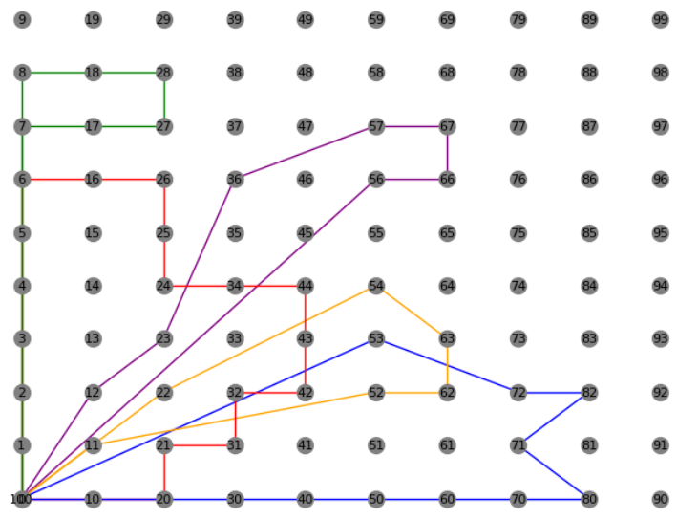
Millions of possible routes: perfect for Column Generation method
Iterative method that provides an attractive route based on the reduced costs of the master problem (MP)
Easily connected to Pulse algorithm that dramatically accelerates subproblem’s computation time
Leonardo Lozano, Daniel Duque, Andrés L. Medaglia (2015) An Exact Algorithm for the Elementary Shortest Path Problem with Resource Constraints. Transportation Science 50(1):348-357.https://doi.org/10.1287/trsc.2014.0582
Feillet, D. A tutorial on column generation and branch-and-price for vehicle routing problems. 4OR-Q J Oper Res 8, 407–424 (2010). https://doi.org/10.1007/s10288-010-0130-z

Slide 10
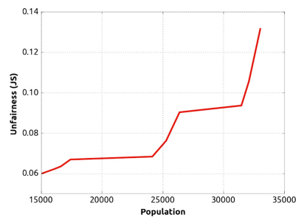
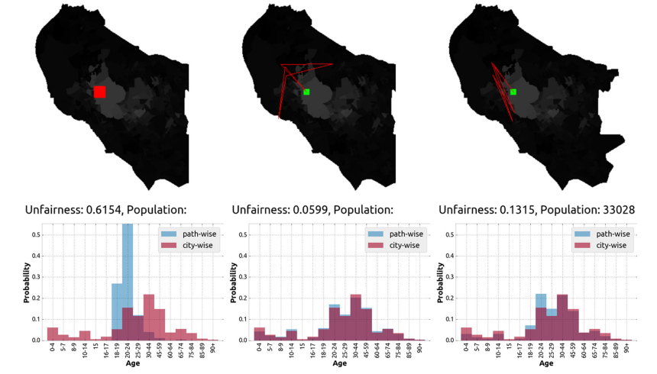
Fair navigation planning in autonomous robots
Unfairness against number of population covered
Works to choose a trade-off between the number of population covered and unfairness in the initial routing planning for the drones
Martim Brandão, Marina Jirotka, Helena Webb, Paul Luff, Fair navigation planning: A resource for characterizing and designing fairness in mobile robots, Artificial Intelligence, Volume 282, 2020, 103259, ISSN 0004-3702, https://doi.org/10.1016/j.artint.2020.103259.

Slide 11
Agenda
Motivation
Mathematical models
Objectives
Column Generation approach
Q-Learning approach
Computational experiments
Conclusions and future work

Slide 12
Agenda
Mathematical models
Objectives
Column Generation approach
Q-Learning approach

Slide 13
Fair routes planning
Maximise node coverage in the initial routing while ensuring fairness in a considerable amount of computation time

Slide 14
Who should the UAVs prioritise and why?
Maximise node coverage in the initial routing while ensuring fairness in a considerable amount of computation time
Tackle ethical dilemmas based on survival probability, battery time and medical resource constraints

Slide 15
Agenda
Mathematical models
Objectives
Column Generation approach
Q-Learning approach

Slide 16

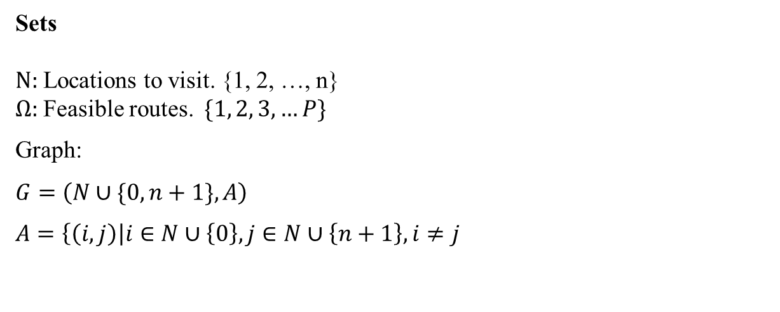
Nomenclature
Sets
$N:$ Locations to visit. {1, 2, …, n}
$Ω:$ Feasible routes. $\{1, 2, 3, …P\}$
Graph:
$G=\left(N∪\{0, n+1\},A\right)$
$A=\left\{\left(i,j\right)\right|i∈N∪\left\{0\right\}, j∈N∪\left\{n+1\right\}, i≠j$

Slide 17
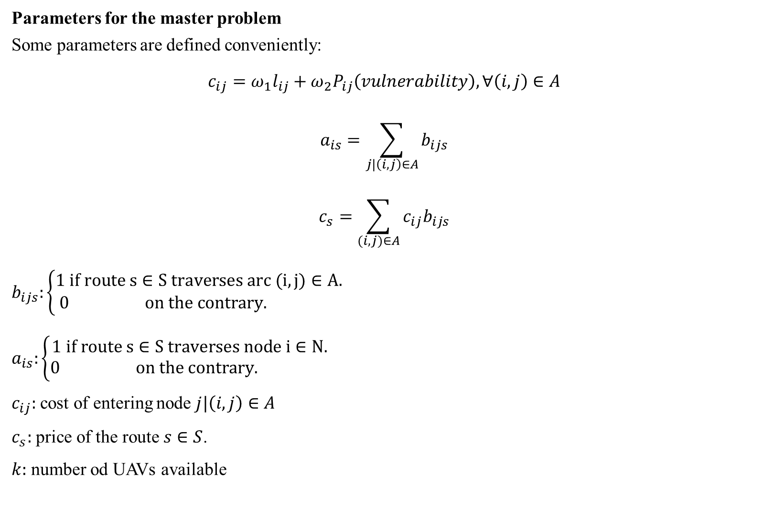
Nomenclature
Parameters for the master problem
Some parameters are defined conveniently:
$${c_{ij}=ω}_{1}l_{ij}+ω_{2}P_{ij}\left(vulnerability\right), ∀\left(i,j\right)∈A$$
$$a_{is}=\sum_{j|\left(i,j\right)∈A}{b_{ijs}}$$
$$c_{s}=\sum_{(i,j)∈A}{{c_{ij}b}_{ijs}}$$
$b_{ijs}:\left\{\begin{aligned}1 if route s∈S traverses arc (i,j)∈A. \\ 0 on the contrary. \end{aligned}\right.$
$a_{is}:\left\{\begin{aligned}1 if route s∈S traverses node i∈N. \\ 0 on the contrary. \end{aligned}\right.$
$c_{ij}:$ cost of entering node $j|\left(i,j\right)∈A$
$c_{s}:$ price of the route $s∈S$.
$k:$ number od UAVs available

Slide 18

MP defined as the knapsack problem
$$\max{\sum_{s∈S}{c_{s}θ_{s}}}$$
$$s.t.$$
$$\sum_{s∈S}{a_{is}θ_{s}}≤1, ∀i∈N$$
$$\sum_{s∈S}{θ_{s}}≤k$$
$$θ_{s}∈\left\{0,1\right\}, ∀s∈S$$

Slide 19
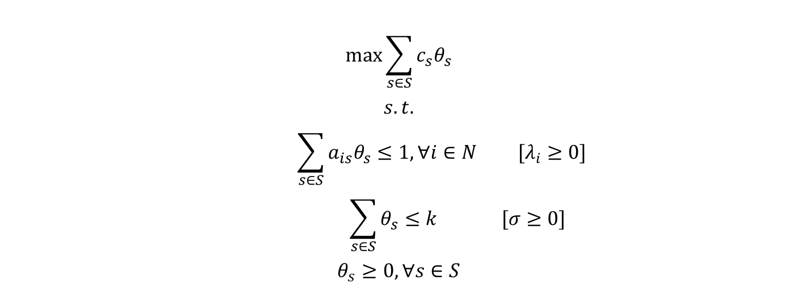
Relaxed MP
$$\max{\sum_{s∈S}{c_{s}θ_{s}}}$$
$$s.t.$$
$$\sum_{s∈S}{a_{is}θ_{s}}≤1, ∀i∈N [λ_{i}≥0]$$
$$\sum_{s∈S}{θ_{s}}≤k [σ≥0]$$
$$θ_{s}≥0, ∀s∈S$$

Slide 20
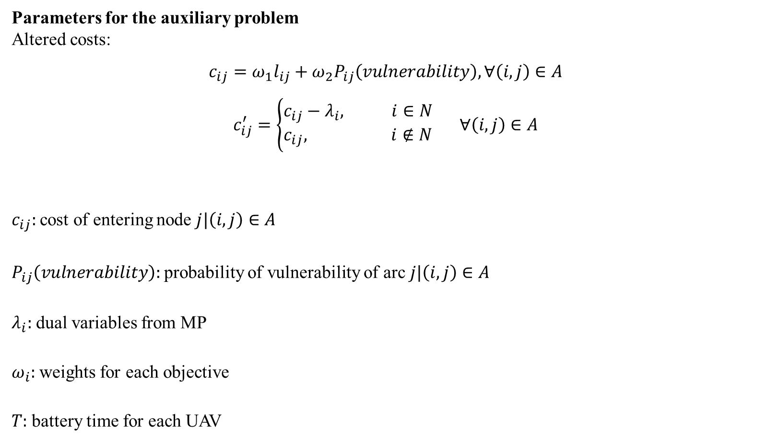
Nomenclature
Parameters for the auxiliary problem
Altered costs:
$${c_{ij}=ω}_{1}l_{ij}+ω_{2}P_{ij}\left(vulnerability\right), ∀\left(i,j\right)∈A$$
$$c_{ij}^{′}=\left\{\begin{aligned}c_{ij}−λ_{i}, i∈N \\ c_{ij}, i∉N\end{aligned}\right. ∀\left(i,j\right)∈A$$
$c_{ij}:$ cost of entering node $j|\left(i,j\right)∈A$
$P_{ij}\left(vulnerability\right):$ probability of vulnerability of arc $j|\left(i,j\right)∈A$
$λ_{i}:$ dual variables from MP
$ω_{i}:$ weights for each objective
$T:$ battery time for each UAV

Slide 21
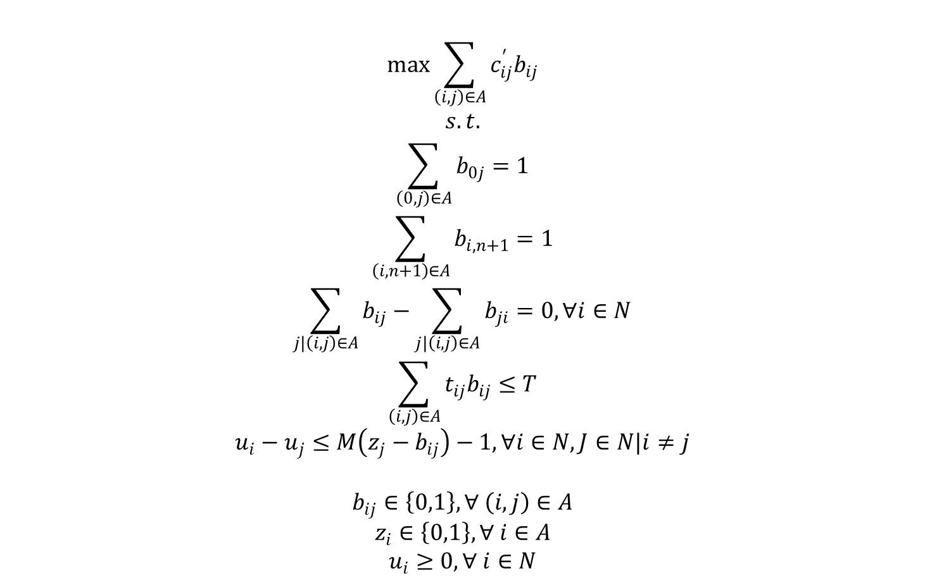
AP defined as the longest-path with resource constraints problem
$$\max{\sum_{\left(i,j\right)∈A}{c_{ij}^{′}b_{ij}}}$$
$$s.t.$$
$$\sum_{\left(0,j\right)∈A}{b_{0j}}=1$$
$$\sum_{\left(i,n+1\right)∈A}{b_{i,n+1}}=1$$
$$\sum_{j|\left(i,j\right)∈A}{b_{ij}}−\sum_{j|\left(i,j\right)∈A}{b_{ji}}=0, ∀i∈N$$
$$\sum_{\left(i,j\right)∈A}{t_{ij}b_{ij}}≤T$$
$$u_{i}−u_{j}≤M\left(z_{j}−b_{ij}\right)−1, ∀i∈N,J∈N|i≠j$$
$$b_{ij}∈\left\{0,1\right\}, ∀ \left(i,j\right)∈A$$
$$z_{i}∈\left\{0,1\right\}, ∀ i∈A$$
$$u_{i}≥0, ∀ i∈N$$

Slide 22

Cuts added to AP iteratively to prevent repetitive routes
$$\sum_{\left(i,j\right)∈A_{s}}{b_{ij}}≤\left|A_{s}\right|−1 |s∈S$$

Slide 23
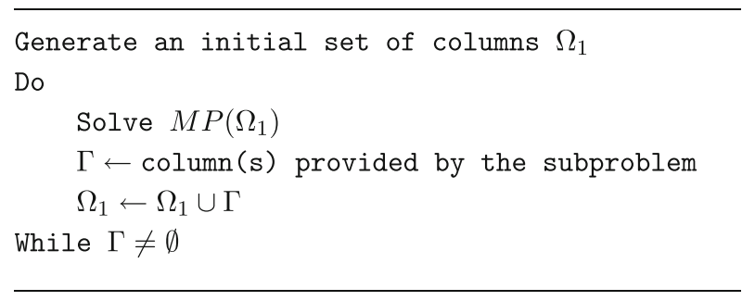
Column Generation procedure
Feillet, D. A tutorial on column generation and branch-and-price for vehicle routing problems. 4OR-Q J Oper Res 8, 407–424 (2010). https://doi.org/10.1007/s10288-010-0130-z

Slide 24
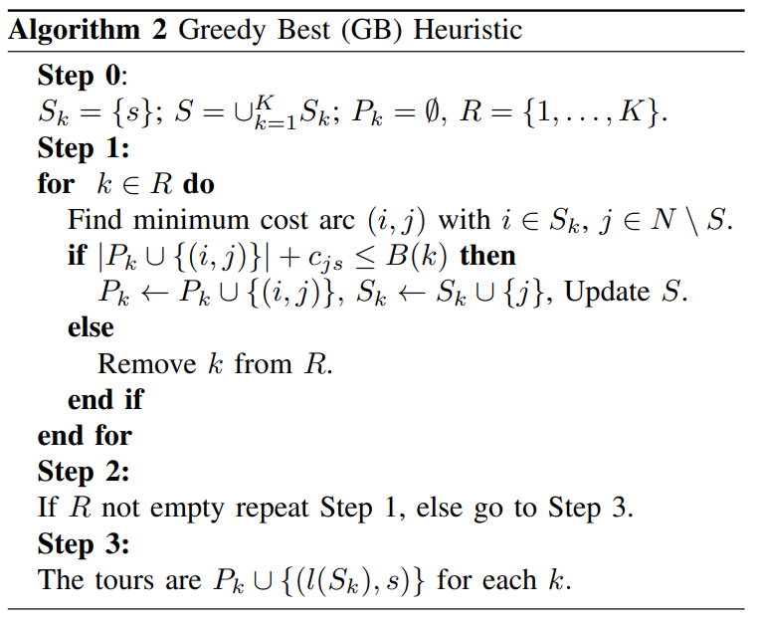
Column Generation enhancement with warm-start
A. Anastasiou, P. Kolios, C. Panayiotou and K. Papadaki, "Swarm Path Planning for the Deployment of Drones in Emergency Response Missions," 2020 International Conference on Unmanned Aircraft Systems (ICUAS), Athens, Greece, 2020, pp. 456-465, doi: 10.1109/ICUAS48674.2020.9213876.

Slide 25
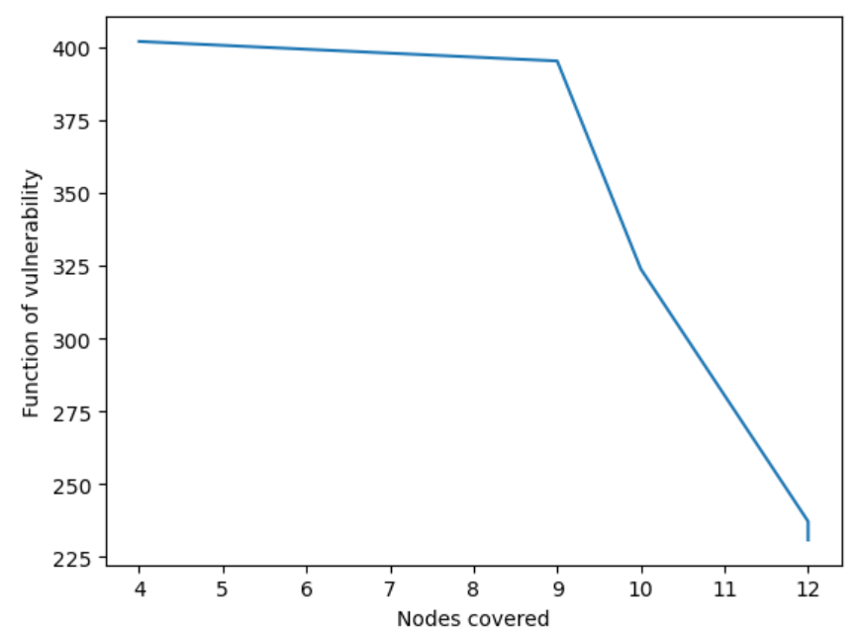
Pareto front for a small instance
George Mavrotas, Effective implementation of the ε-constraint method in Multi-Objective Mathematical Programming problems, Applied Mathematics and Computation, Volume 213, Issue 2, 2009, Pages 455-465, ISSN 0096-3003, https://doi.org/10.1016/j.amc.2009.03.037.

Slide 26
Agenda
Mathematical models
Objectives
Column Generation approach
Q-Learning approach

Slide 27
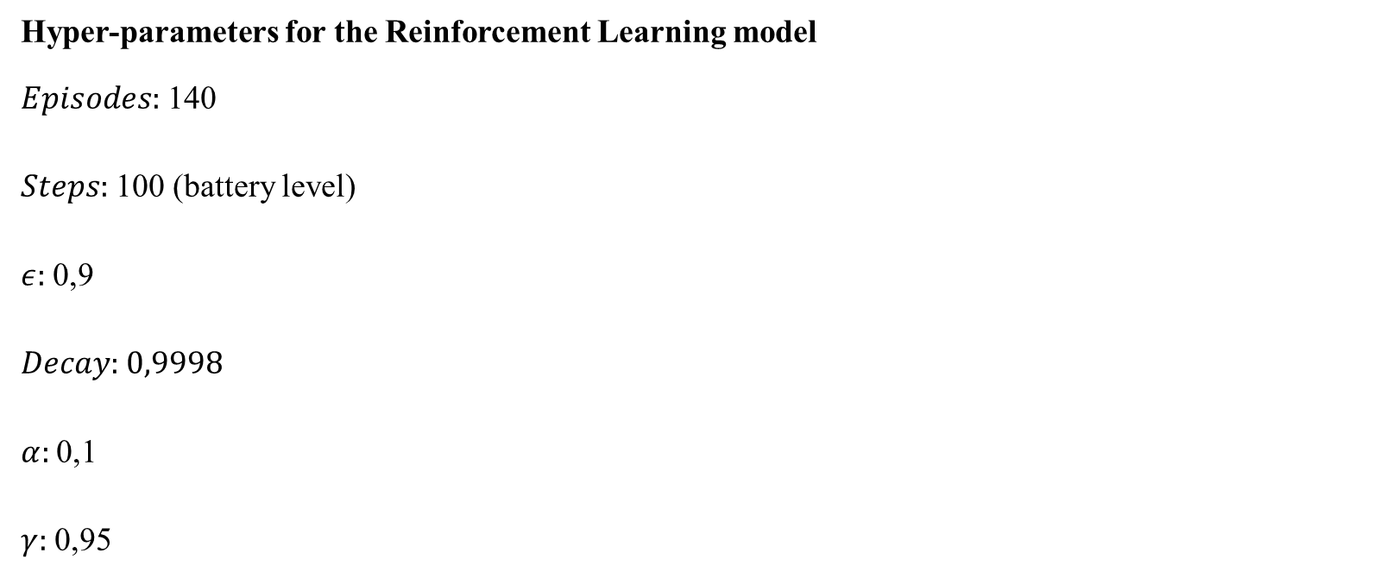
Nomenclature
Hyper-parameters for the Reinforcement Learning model
$Episodes:$ 140
$Steps:$ 100 (battery level)
$ε:$ 0,9
$Decay:$ 0,9998
$α:$ 0,1
$γ:$ 0,95

Slide 28
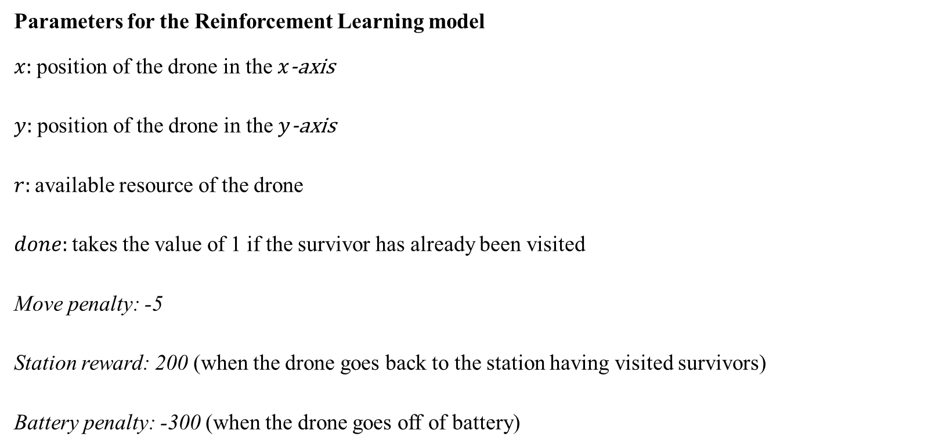
Nomenclature
Parameters for the Reinforcement Learning model
$x:$ position of the drone in the $x$-axis
$y:$ position of the drone in the $y$-axis
$r:$ available resource of the drone
$done:$ takes the value of 1 if the survivor has already been visited
Move penalty: -5
Station reward: 200 (when the drone goes back to the station having visited survivors)
Battery penalty: -300 (when the drone goes off of battery)

Slide 29
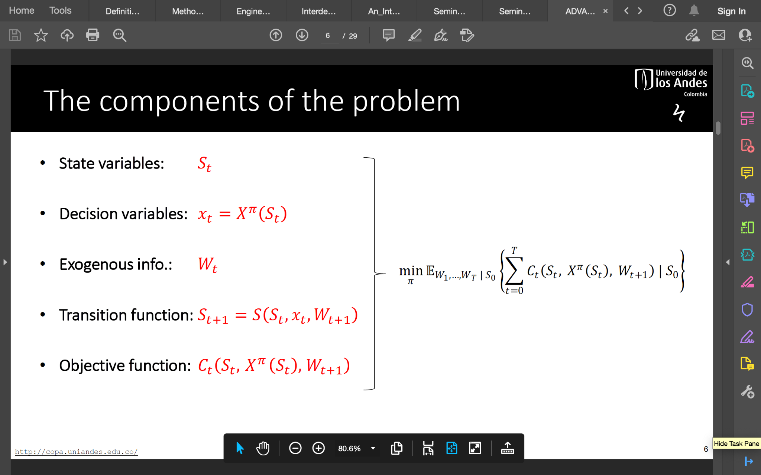
Framework for Stochastic Optimisation
Notes:
Es parecido a un MDP pero sirve para otros approaches

Slide 30
Framework for Stochastic Optimisation
$$S_{t}=\left(x,y,r,done\right)$$
$X_{t}=\left\{x,y, r\right\}$: it can only move between neighbours
$W=\left\{Location of new group of survivors (if there are)\right\}$: for the moment it is deterministic and it is known from the beginning
$$S_{t+1}=S_{X}^{M}\left(S_{t},X_{t},W_{t}\right)$$
$R_{t}\left(S_{t},W_{t},S_{t+1}\right)$: for the moment it only accounts for the number of survivors in the node.
(add survival probability depending on time since disaster)
$$\max{R_{t}}$$
Notes:
Es parecido a un MDP pero sirve para otros approaches

Slide 31
Q-Learning algorithm
Reinforcement Learning Algorithm
Exploration on the environment and exploitation of recollected information
Estimation of a Q-table which is being updated on every episode
$$Q\left(S,A\right)←Q\left(S,A\right)+α\left(R+γ\max_{a}{Q\left(S^{′},a \right)}−Q\left(S,A\right)\right)$$
Notes:
Model free algorithm this means that the agent doesnt need to know the set of parameters but trough exploration it Will learn from the env.

Slide 32
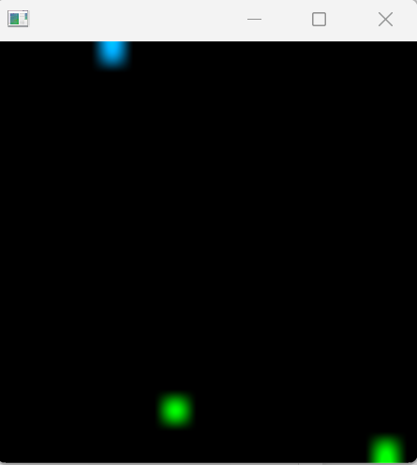


Framework for Stochastic Optimisation
Charging depot: top left corner
Survivors: green nodes
Drone: blue node
Notes:
Es parecido a un MDP pero sirve para otros approaches

Slide 33
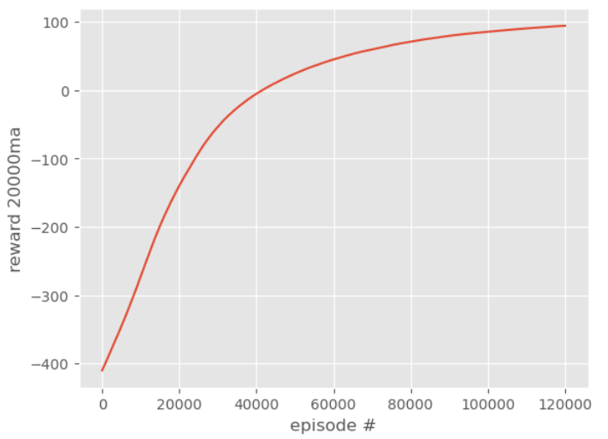
Learning curve
Notes:
Es parecido a un MDP pero sirve para otros approaches

Slide 34
Agenda
Motivation
Mathematical models
Objectives
Nomenclature
Parameters
Column Generation approach
Q-Learning approach
Computational experiments
Conclusions and future work
Notes:
GUIOON

Slide 35
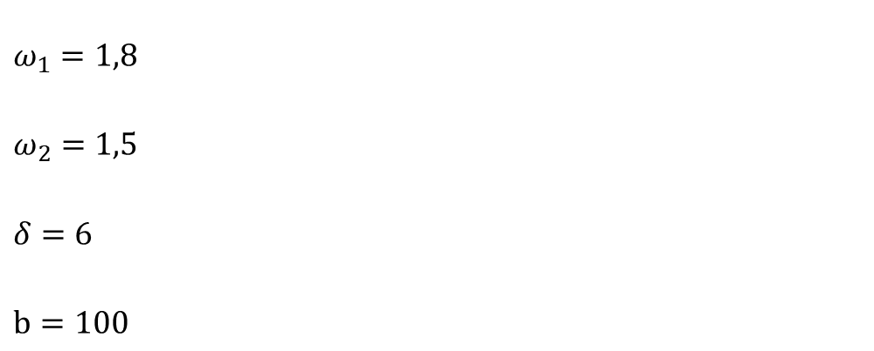
Los parámetros iniciales para correr el modelo
$ω_{1}=1,8$
$ω_{2}=1,5$
$δ=6$
$b=100$

Slide 36
Agenda
Motivation
Mathematical models
Objectives
Nomenclature
Parameters
Column Generation approach
Q-Learning approach
Computational experiments
Conclusions and future work
Notes:
GUIOON

Slide 37
Conclusions and Future Work
We implemented a computational environment to model Cyber-Physical Systems under the framework of sequential stochastic decisions, providing a basis for experimentation with policies based on different types of techniques
The proposed proof of concept evidences the potential of the proposed environment by comparing exact and approximate policies

Slide 38
Conclusions and Future Work
Include a defender agent to analyze preventive and reactive actions to reduce impact of attacks
Build more complex instances to evaluate and improve the robustness of our approach and algorithms
Explore other Reinforcement Learning Algorithms, Deep RL and solution approaches

Slide 39


Thanks!
gr.pardo@uniandes.edu.co
https://copa.uniandes.edu.co/

Slide 40

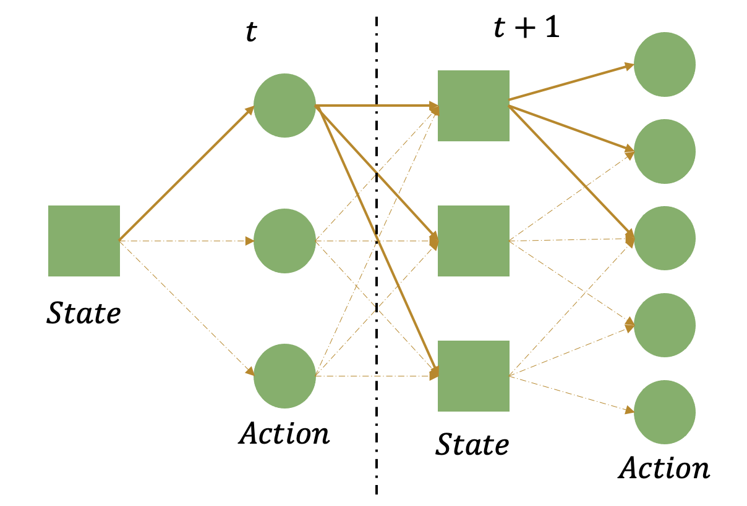
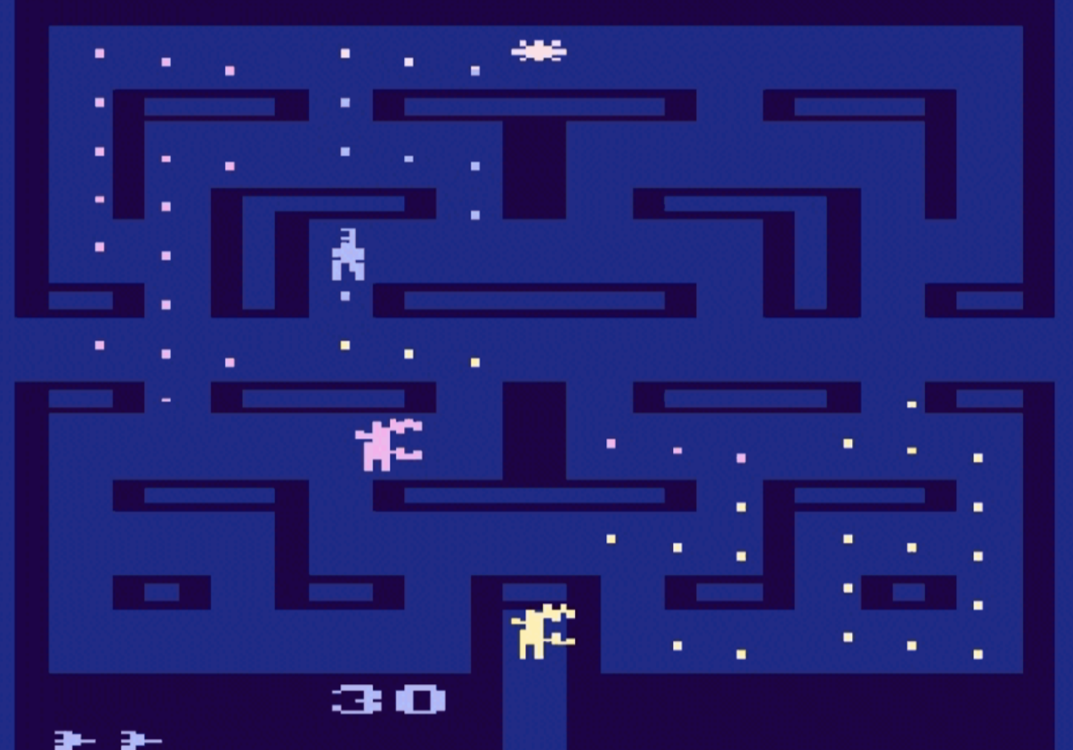
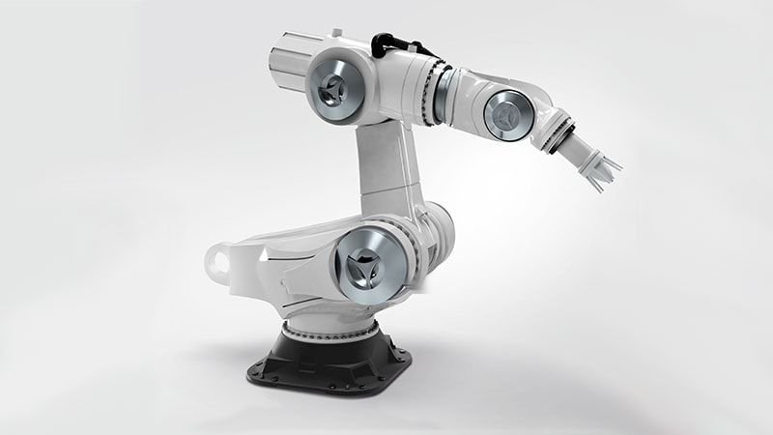
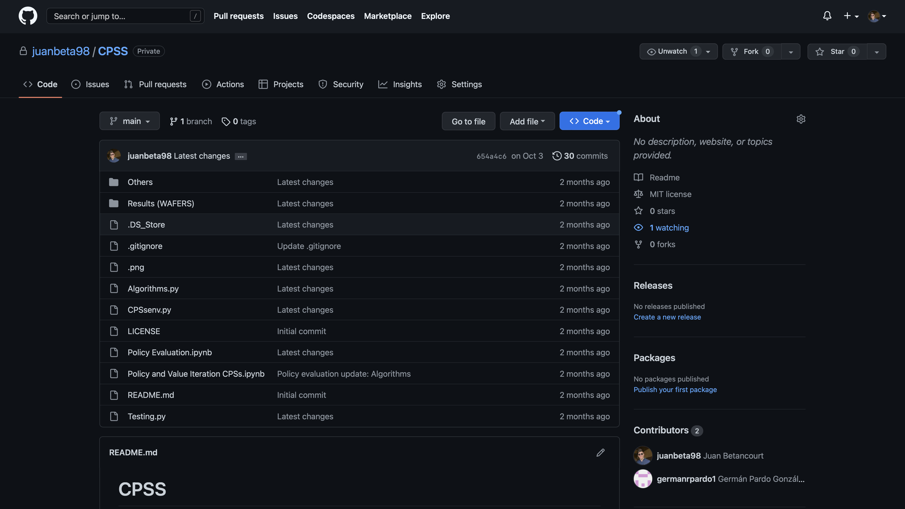
Framework for Stochastic Optimization
Notes:
General Stochastic Framework
OPENAI is an organization focused on AI

Slide 41
Framework for Stochastic Optimization
Notes:
Es parecido a un MDP pero sirve para otros approaches

Slide 42



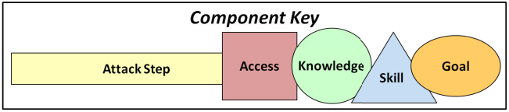
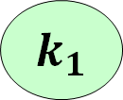
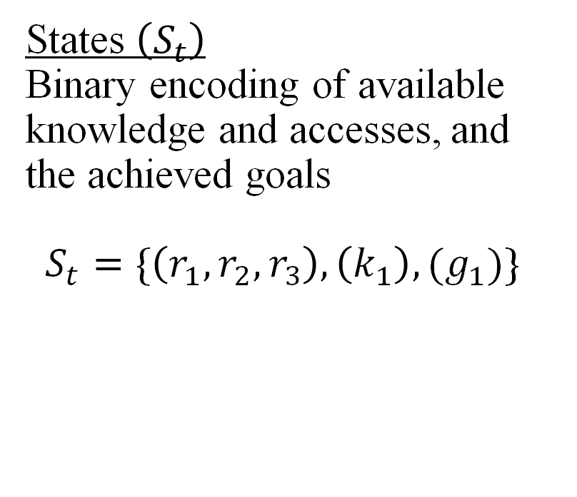
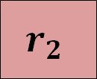
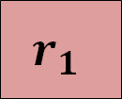
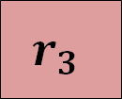



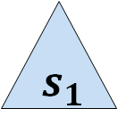
ADVISE as a Sequential Decision Process
$$r_{1}$$
$$s_{1}$$
$${ k}_{1}$$
States $\left(S_{t}\right)$
Binary encoding of available
knowledge and accesses, and
the achieved goals
$$S_{t}=\{\left(r_{1},r_{2},r_{3}\right), \left(k_{1}\right), (g_{1})\}$$
$$a_{1}$$
$$r_{2}$$
$$r_{3}$$
$$a_{2}$$
$${ g}_{1}$$
Notes:
How would this framework look in CPS

Slide 43
Computational Environment
Computational tool
Simulates the system’s dynamics under the Decision Process model
Emulates the transition and reward functions
Notes:
This computational tool is called the environment

Slide 44
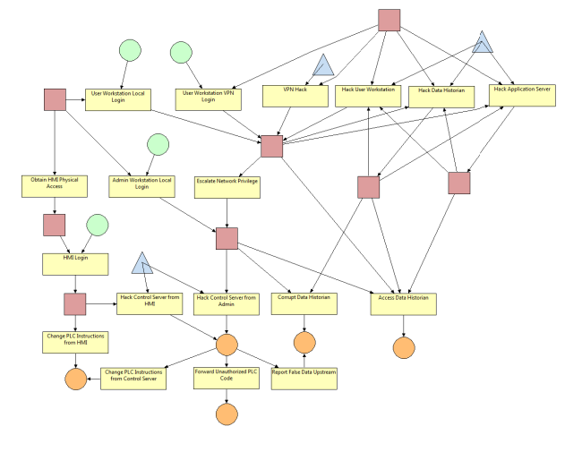
Computational Environment
Environment’s main aspects
1. Complete instance generation
2. Facilitates experimenting
on the system
3. Decision Analytics
Notes:
Some of the characteristics of the environment are the capability to model a complete instance, so
It can receive an instance in format HTML from ADVISE and build the MDP tree

Slide 45
Outline
Proposed approach
Recognize ADVISE models as Markov Decision Processes (MDP)
Adopt a general Stochastic Optimization Framework
Develop an OpenAI-consistent computational environment
Implement basic attacker agent policies
Notes:
Finally, we’d like to propose some attacker policies with two algorithms

Slide 46

Value Iteration
Dynamic Programming algorithm
Iteratively estimates the value of a state, how valuable it is to be in that state
Converges to optimum, sets a benchmark
$$v\left(s\right)=\max_{a∈A}\left\{𝔼[v(s)|s′,a]\right\}$$
Notes:
Model based algorithm that means that parameters must be known beforehand to make the computation

Slide 47
Outline
Applications in airlines
Proposed approach
Research objectives
Nomenclature
The mathematical optimisation model
Computational experiments
Pareto front and decision-making approach
Closure
Notes:
GUIOON

Slide 48
ADVISE representation of a SCADA system
E. LeMay, M. D. Ford, K. Keefe, W. H. Sanders and C. Muehrcke, "Model-based Security Metrics Using ADversary VIew Security Evaluation (ADVISE)," 2011 Eighth International Conference on Quantitative Evaluation of SysTems, 2011, pp. 191-200, doi: 10.1109/QEST.2011.34.
Notes:
Components and conventions

Slide 49
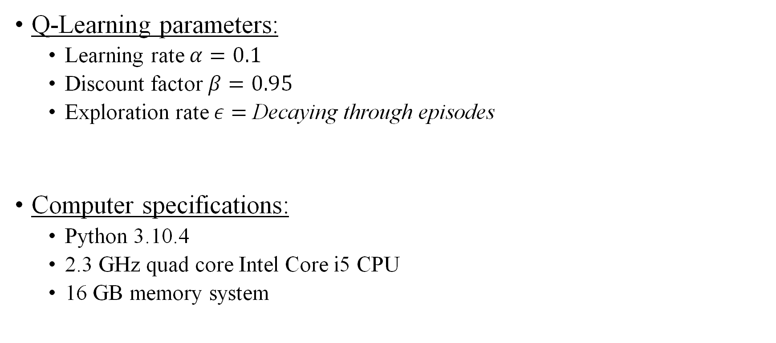
Experiment configuration
Q-Learning parameters:
Learning rate $α=0.1$
Discount factor$β=0.95$
Exploration rate $ε=$Decaying through episodes
Computer specifications:
Python 3.10.4
2.3 GHz quad core Intel Core i5 CPU
16 GB memory system
Notes:
In terms of the algorithms

Slide 50
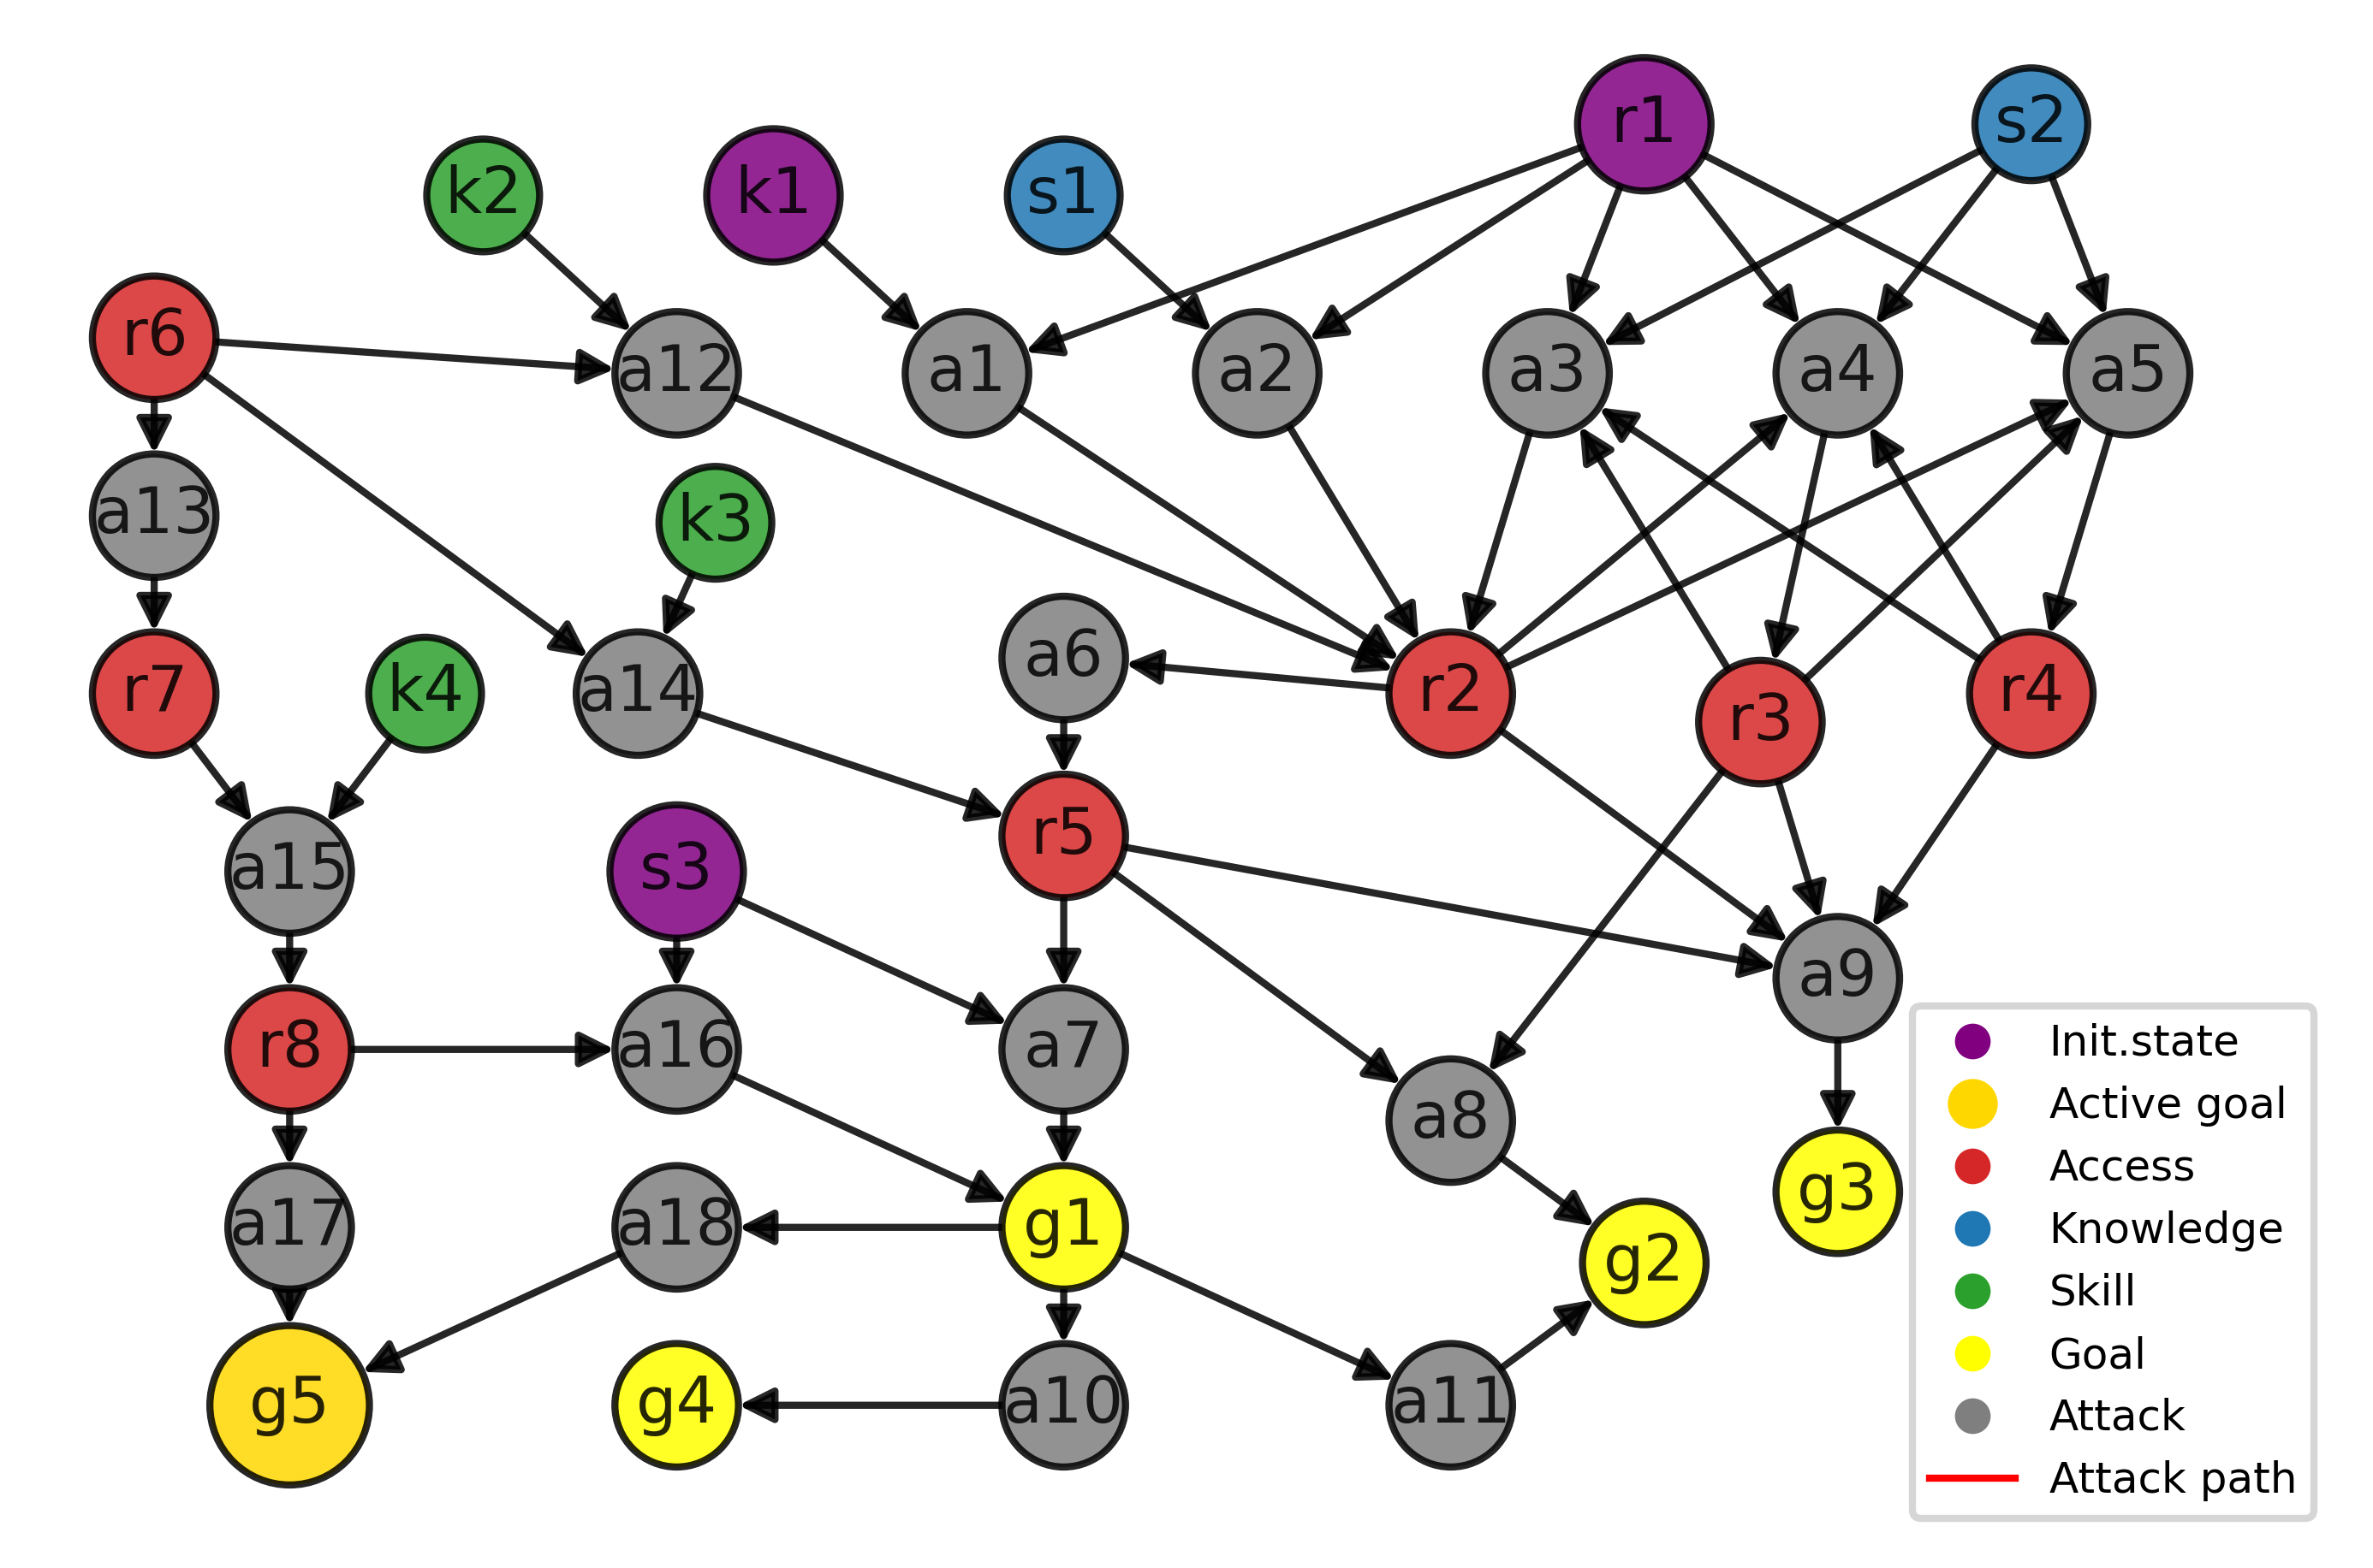
Experiment 1
Access 1
Knowledge 1
Skill 3
Pursue Goal 5
Maximum of 6 steps
Notes:
We simulated that an attacker would have

Slide 51
Outline
Attacks in Cyber-Physical Systems
Proposed approach
Recognize ADVISE models as Markov Decision Processes (MDP)
Adopt a general Stochastic Optimization Framework
Develop an OpenAI-consistent computational environment
Implement basic attacker agent policies
Computational experiments
Closure
Notes:
Finally, to close this presentation we’d like to

